Slide 1

Credit EDA Assignment
Deeksha Sethi

Slide 2
Background & Business Objective- Credit EDA Case Study
Background:
A bank is a financial institution that provides a range of services related to money, finance, and banking. Borrowers apply for loan or credit, there are possibly two risks associated with with the bank’s decision-
If the applicant is likely to repay the loan:
not approving the loan results in a loss of business to the company.
he/she is likely to default, then approving the loan may lead to a financial loss for the company.
Business Objective:
To identify variables which are strong indicators of default and potentially use the insights in approval / rejection decision making.

Slide 3
Data Understanding
Applicant's Age & Demographic
Credit Amount.
Family Status.
Annual Income.
Relative population.
Loan Information
Customer Behaviour
Education type.
Type of Credit.
Loan Purpose.
Types of variables

Slide 4

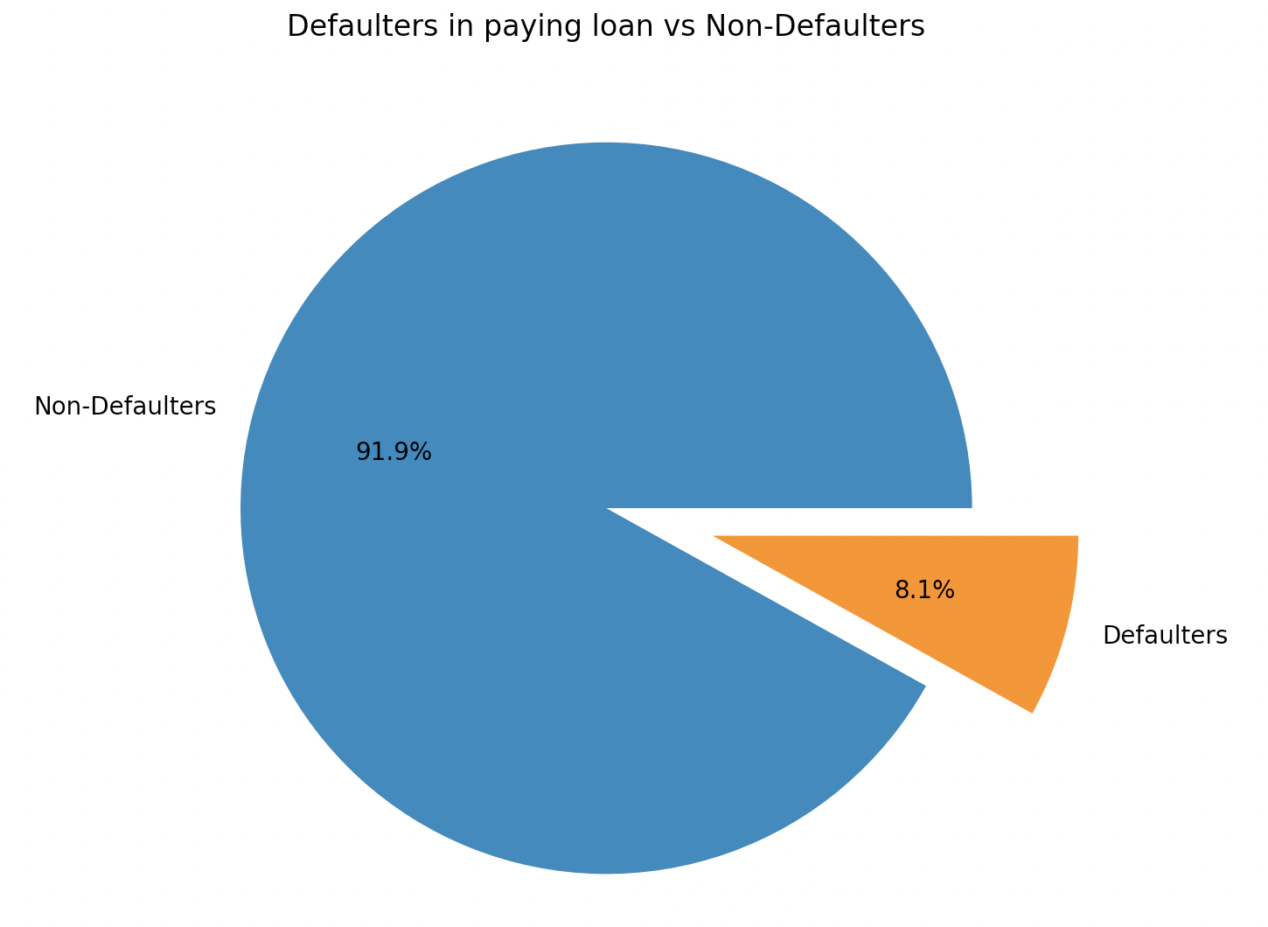

Data Understanding- Non-Defaulters vs Defaulters
z

Slide 5
Non-Defaulters, Target=0
Categorical Univariate Analysis
Correlation
Bivariate Analysis

Slide 6
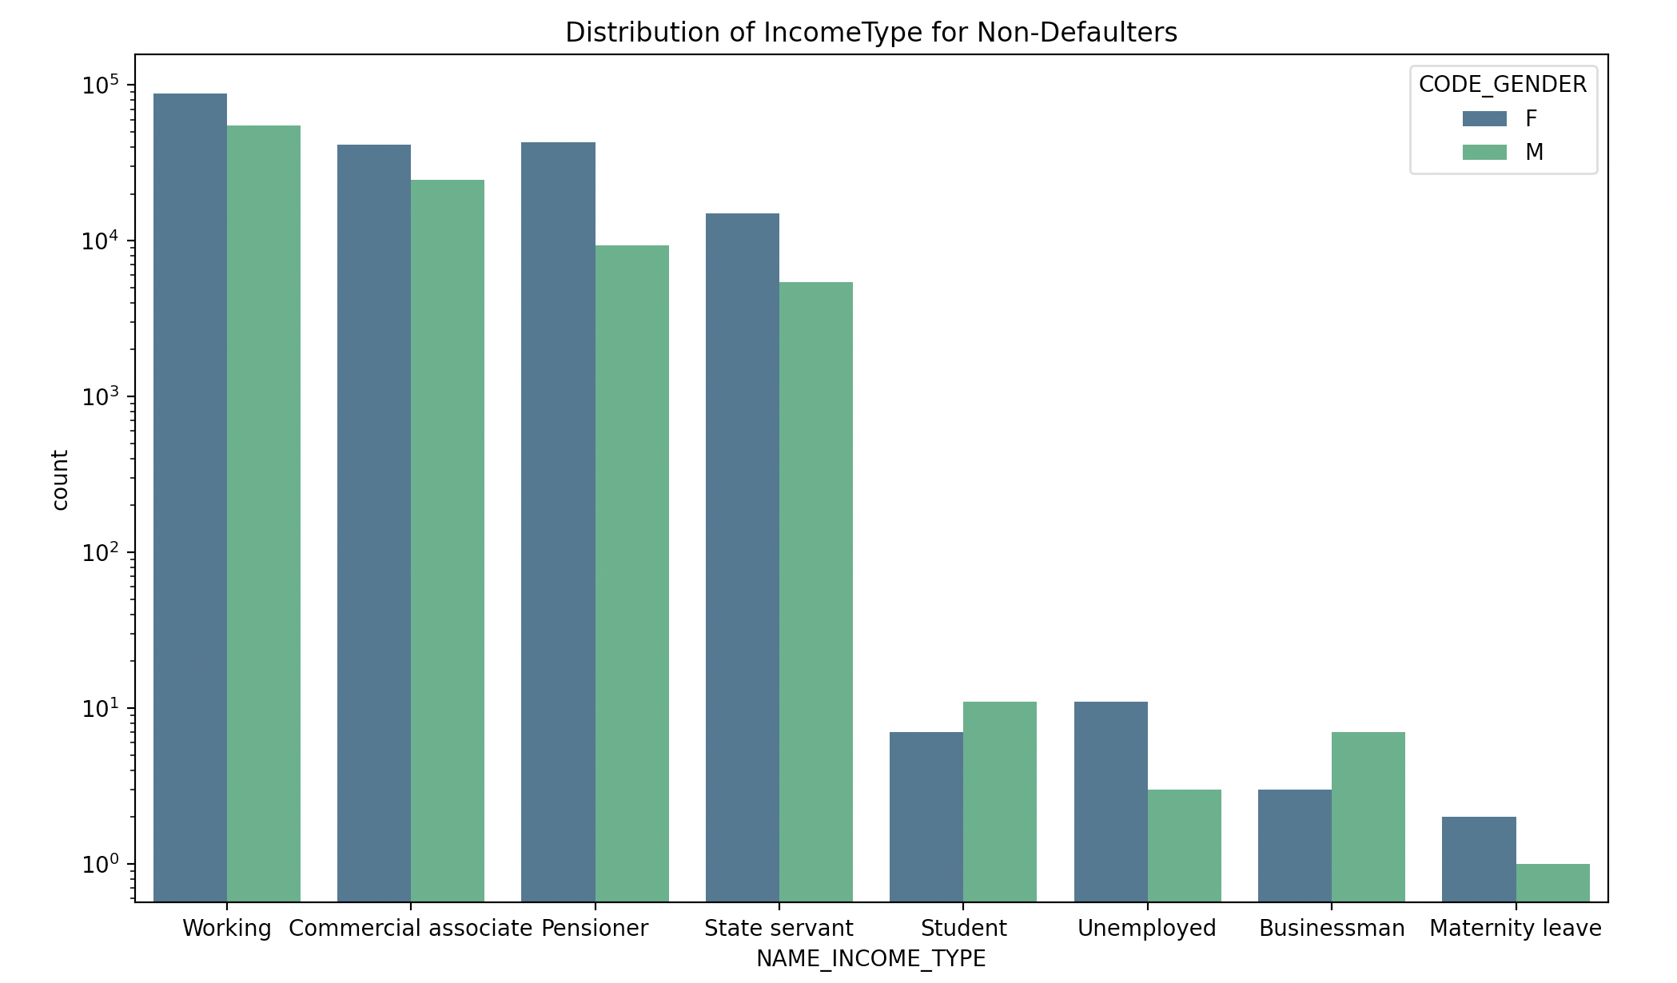
Distribution Of Income Type
People with Income type -'Working', 'Commercial associate', 'State Servant' and 'Pensioner' are more likely to take up credits.
Females are having a greater number of credits than male.
Less number of credits for income type 'Unemployed' 'Student', 'Businessman' and 'Maternity leave'.

Slide 7
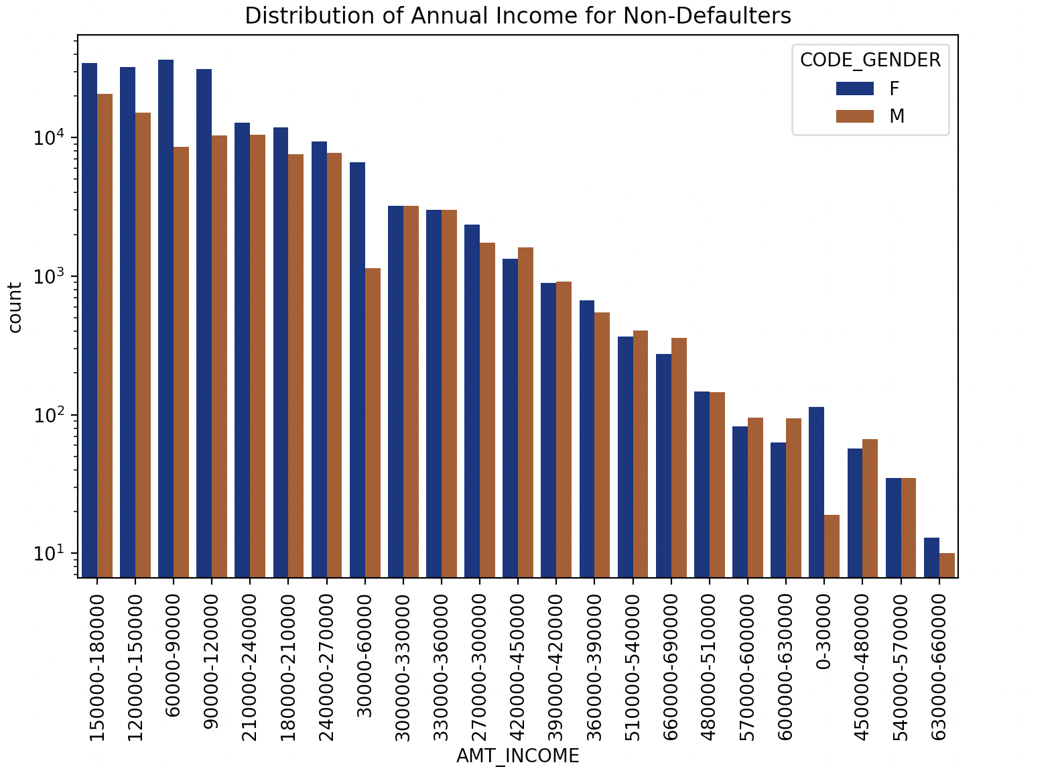
Distribution Of Annual Income
Income range from 60000 to 210000 is having a greater number of credits and Female are leading male for this range.
In general, Female counts are higher than male.
Count is less for range 630000 and above.

Slide 8
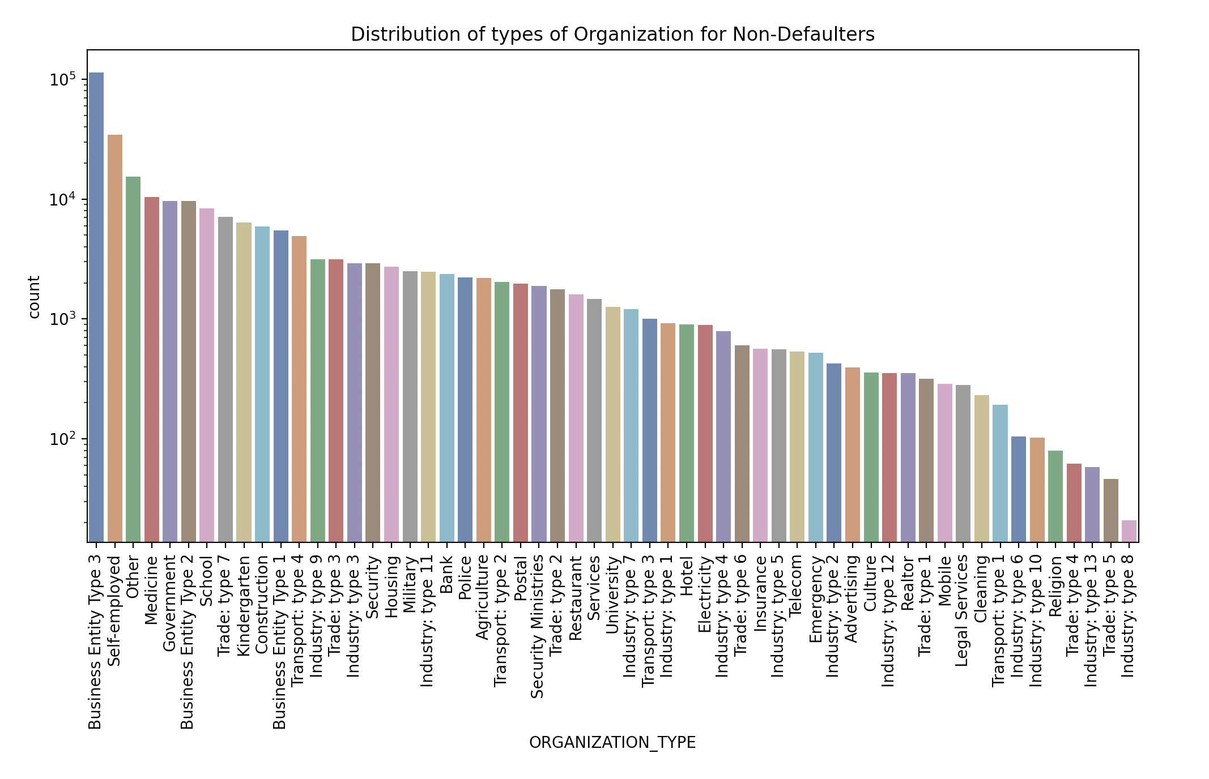
Distribution Of Organization Type
Clients which have applied for loans are from organization types- 'Business entity Type 3', 'Self employed', 'Other' , 'Medicine' and 'Government’.
Less clients are from Industry type 8,Trade type 5.

Slide 9
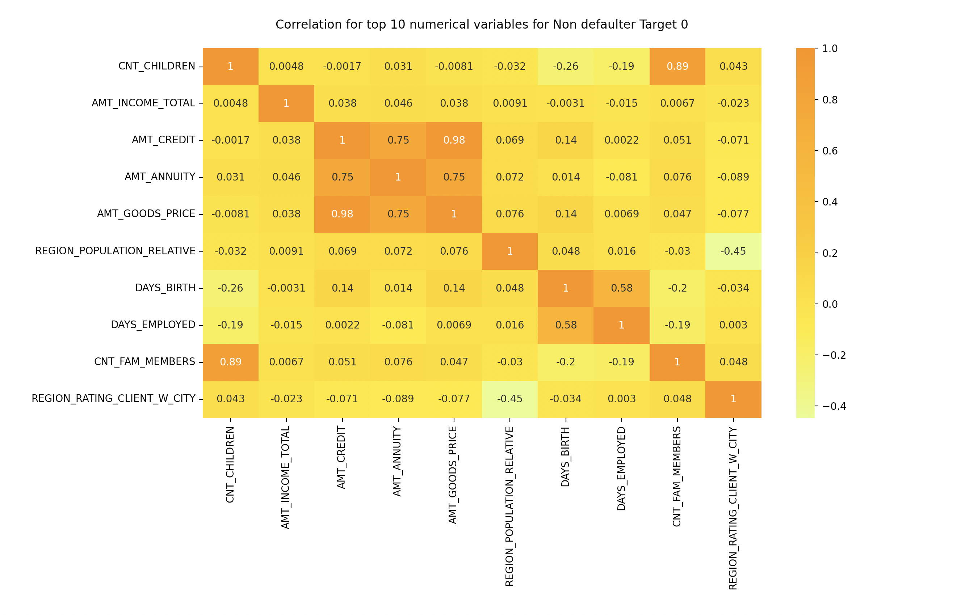
Correlation
In densely populated area, number of children are less. Both are inversely proportional.
Amount of Credit is linear with or proportional with Amount of Goods.
Annual Income is inversely proportional to the age.
Amount of Annuity is having linear relationship with Amount of Credit.
Higher is your age, higher is your days employed.
Amount Credit amount is inversely proportional to the count of children.
Higher is the count of family members, higher is the number of children in the family.

Slide 10
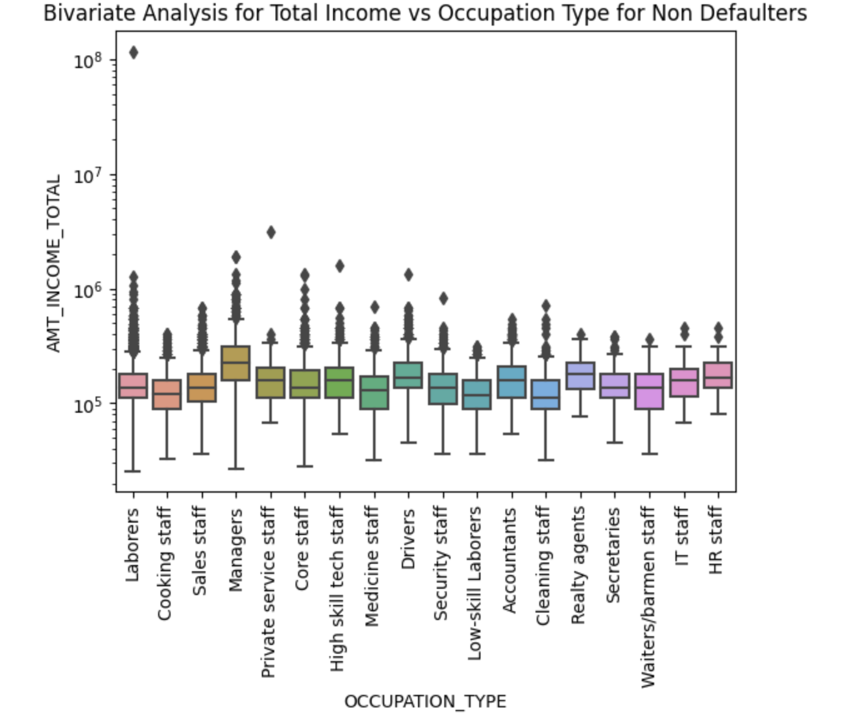
Distribution Of Total Income with Occupation Type
Managers are having higher income than other.
Outliers are present for all Occupation types. Realty Agents, Barmen staff, have very less outliers.
Cleaning staff has less income.

Slide 11
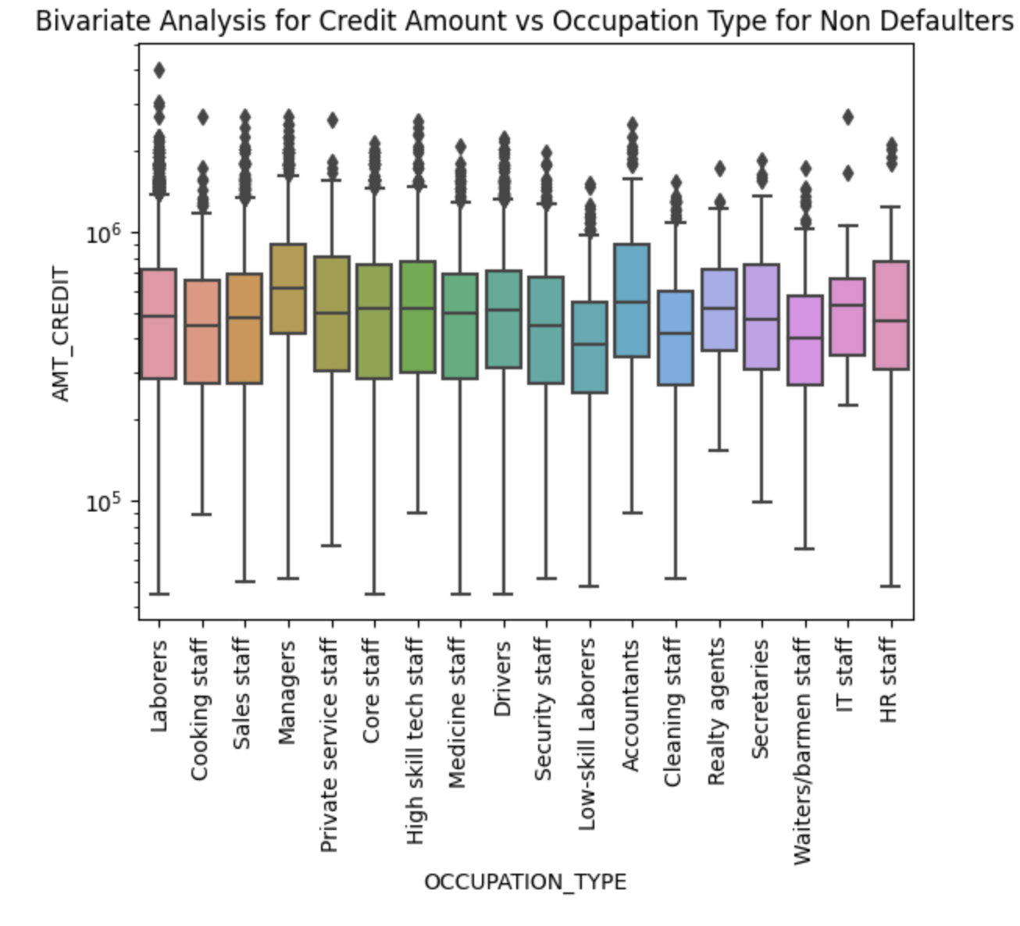
Distribution Of Credit Amount with Occupation Type
Managers are having higher credits than other.
Outliers are present for all Occupation types.
Low skill labourers has minimum credits.

Slide 12
Defaulters, Target=1
Categorical Univariate Analysis
Correlation
Bivariate Analysis
z

Slide 13
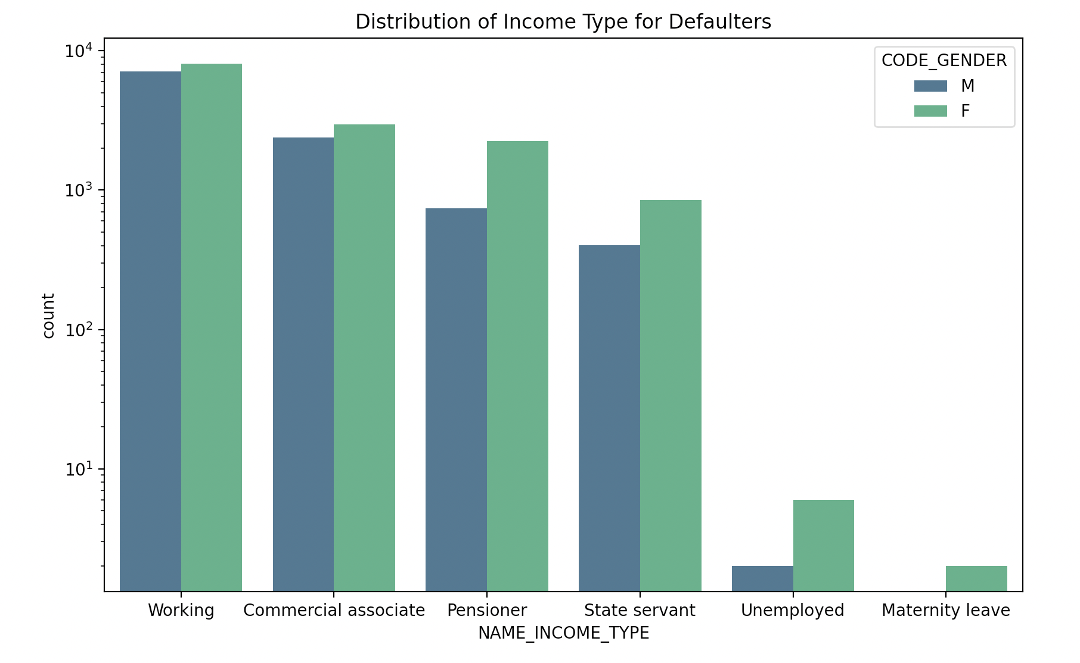
Distribution Of Income Type
For income type 'working', 'commercial associate', the number of credits are maximum.
No credits for income type ‘Maternity leave’.
Females are having more credits than male.
When we compare this graph (Defaulters) with graph plotted for (Non-defaulters), Businessman, Students data is not present, means they didn't do any default or has difficulty in repayment of loans.

Slide 14
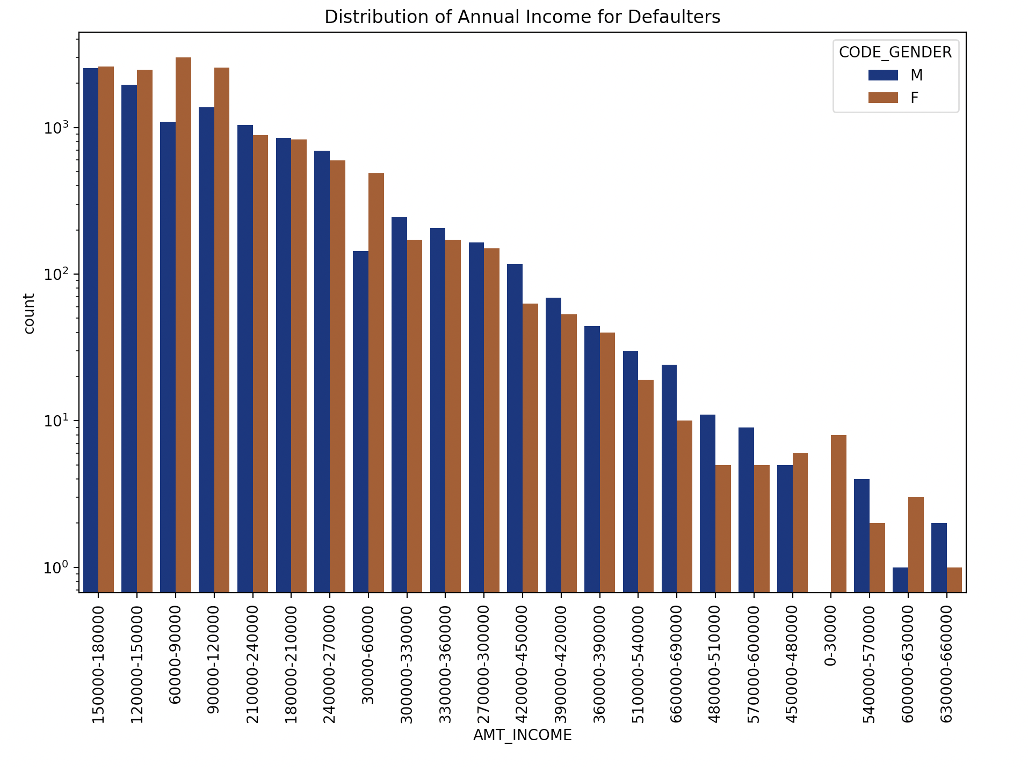
Distribution Of Annual Income
Income range from 90000 to 180000 is having a greater number of credits and Female are leading male for this range.
In general, Male counts are higher than female.
Count is less for range 630000 and above.

Slide 15
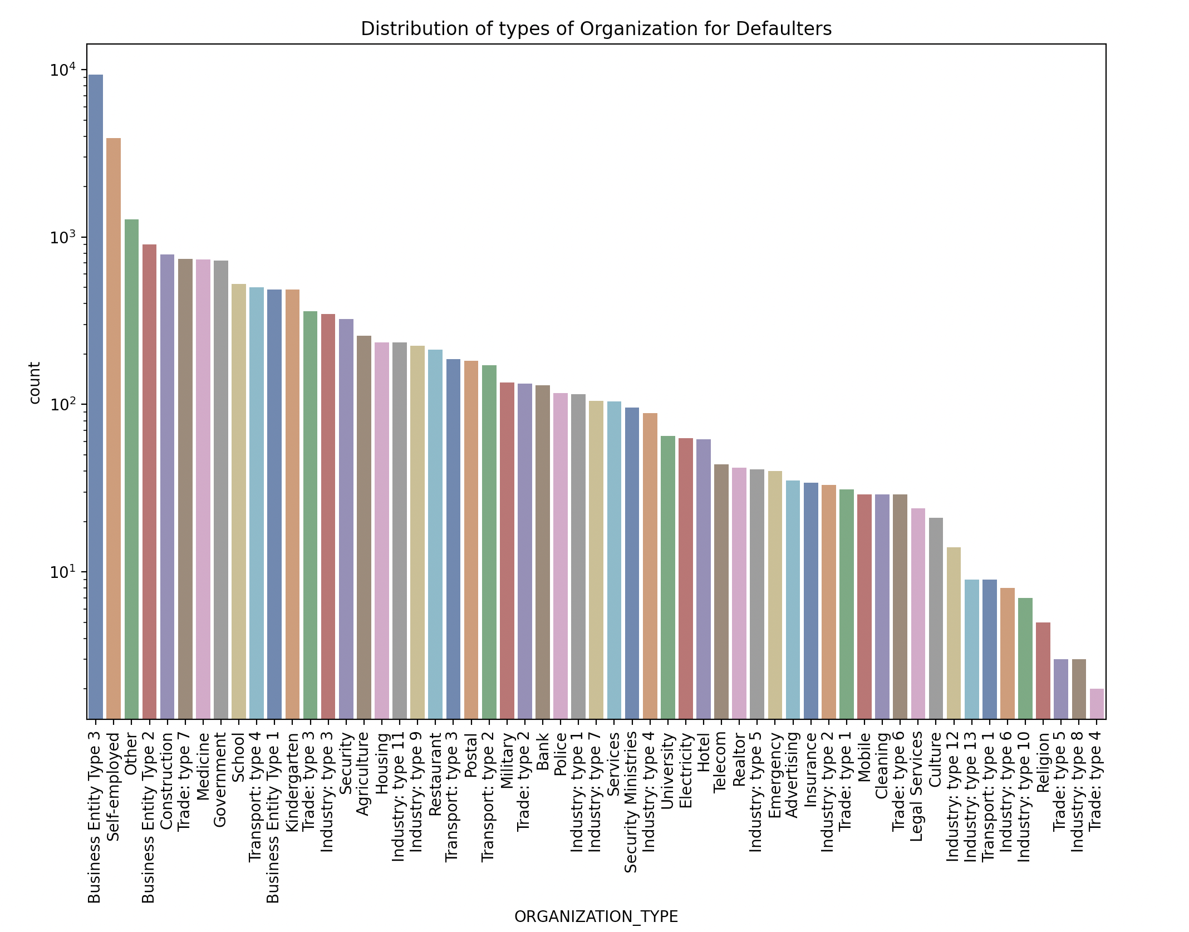
Distribution Of Organization Type
Clients which have applied for loans are from organization types- 'Business entity Type 3', 'Self employed', 'Other' , 'Medicine' and 'Government’.
Less clients are from Industry type 8,Trade type 5.

Slide 16
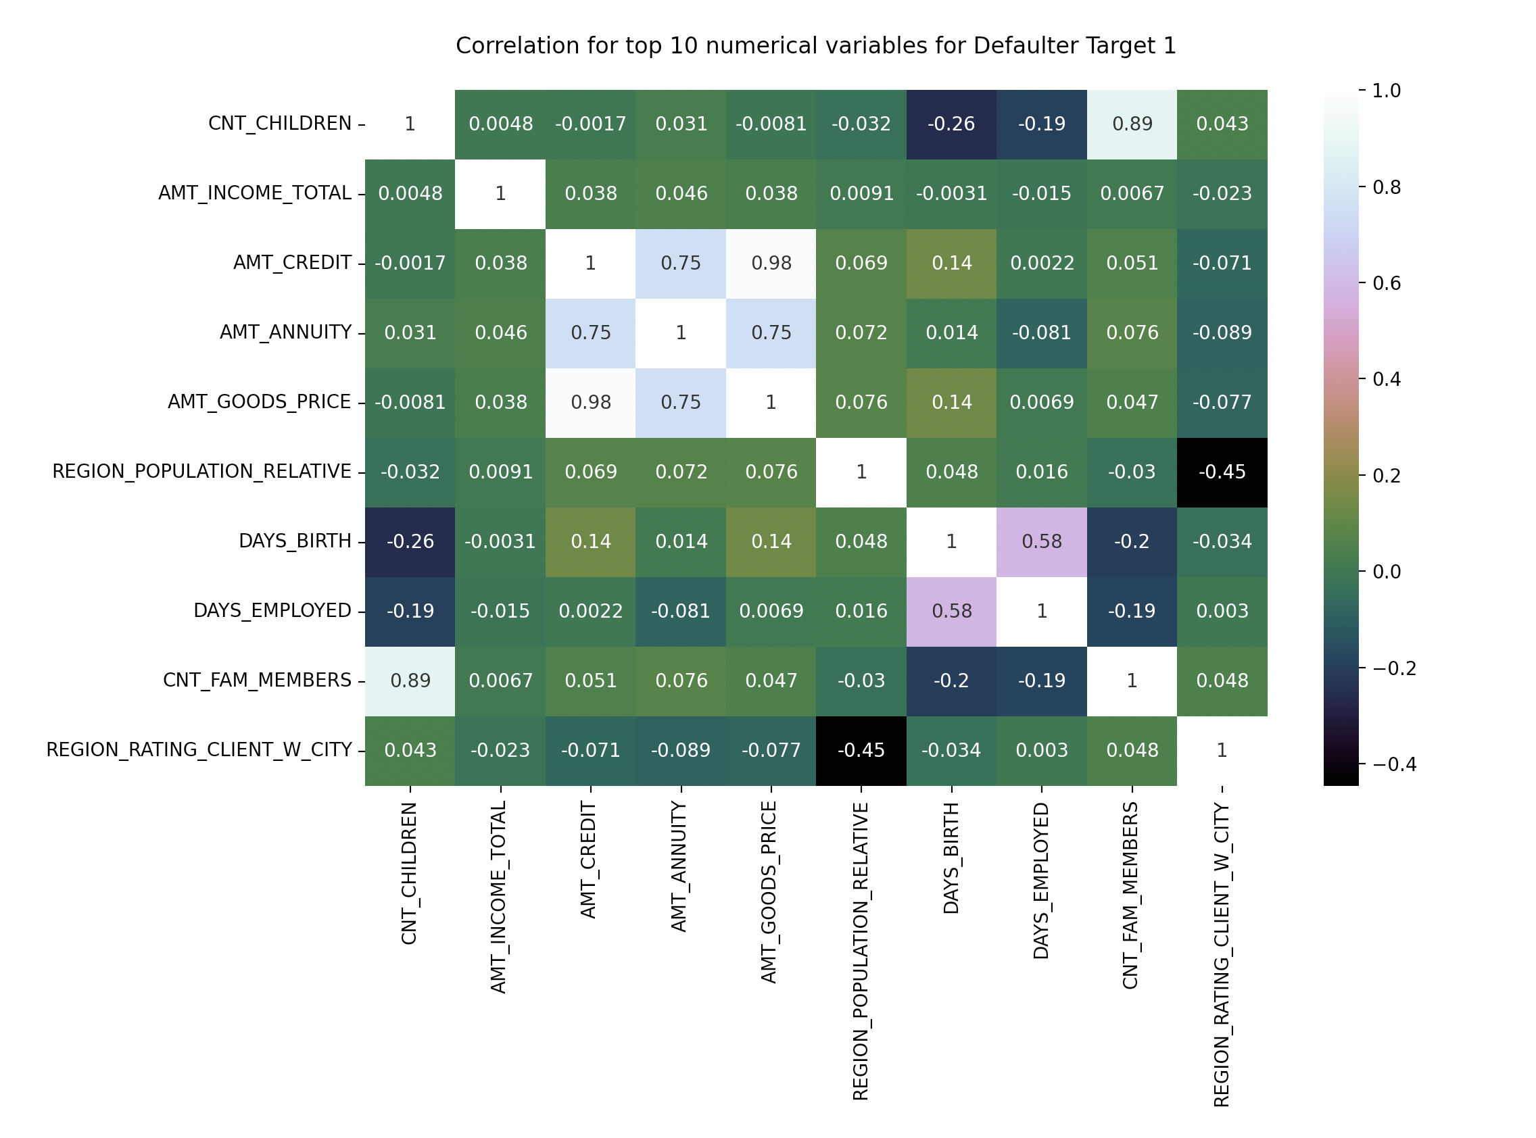
Correlation
Client's social surroundings with observable 30 DPD (days past due) increases linearly with defaulted on 30 DPD (days past due).
Age is inversely proportional to family count.
In densely populated area, number of children are less. It is inversely proportional. More densely populated, less is the children count and vice-versa.
Annual Income is inversely proportional to the age.

Slide 17
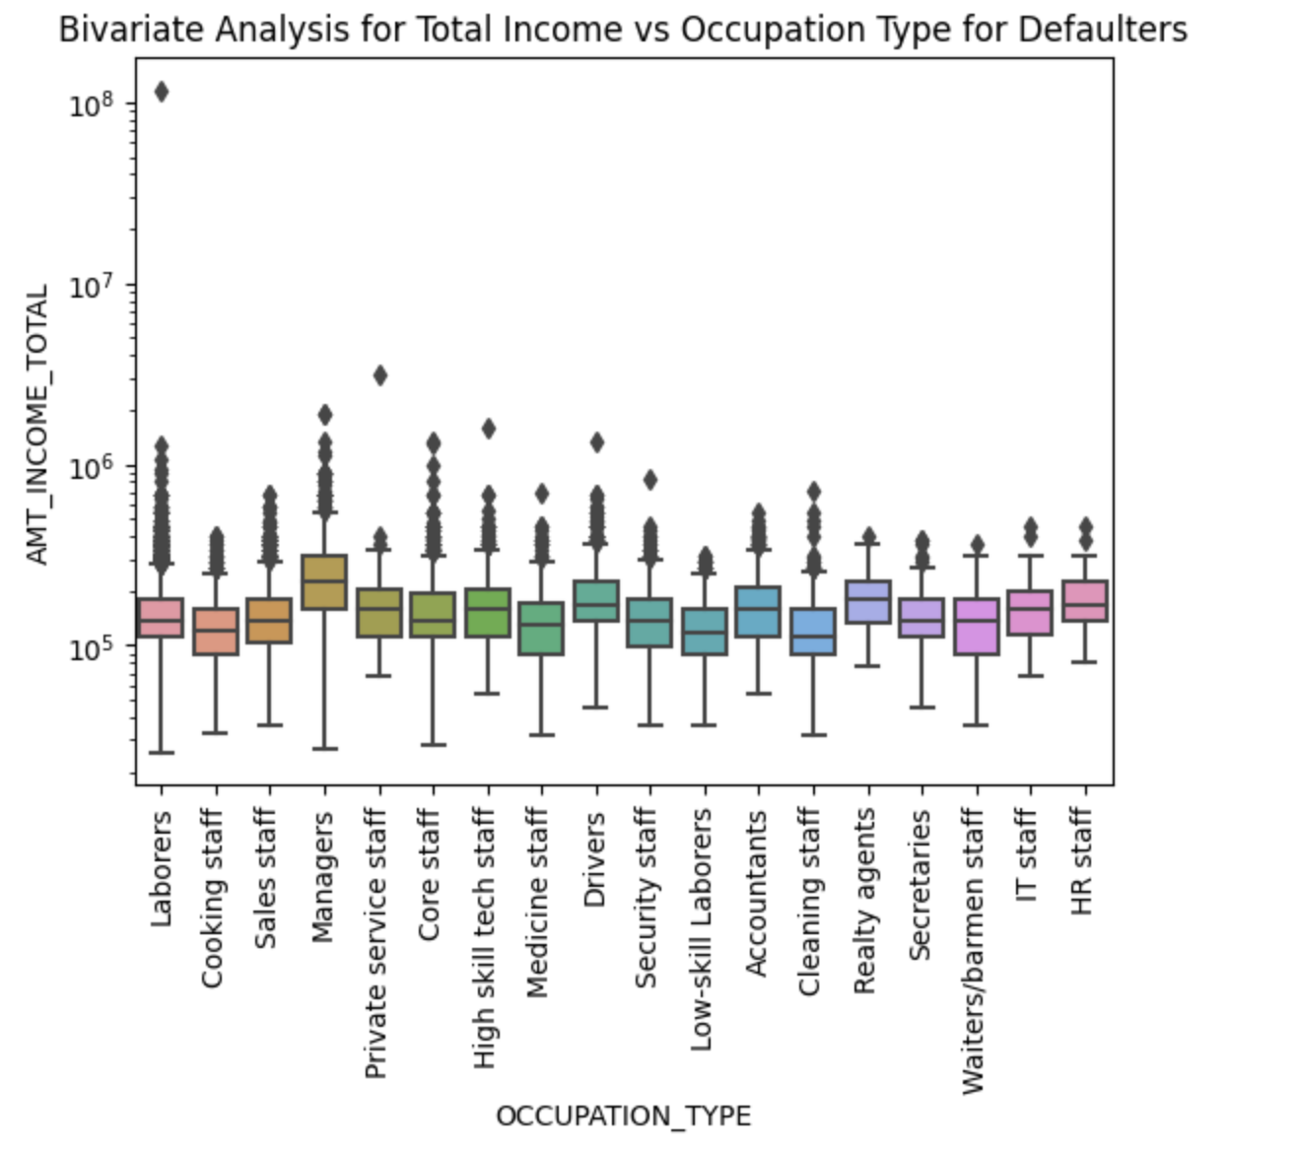
Distribution Of Total Income with Occupation Type
Managers are having higher income than other.
Outliers are present for all Occupation types. Realty Agents, Barmen staff, IT staff are having very less outliers.
Cleaning staff has less income.

Slide 18
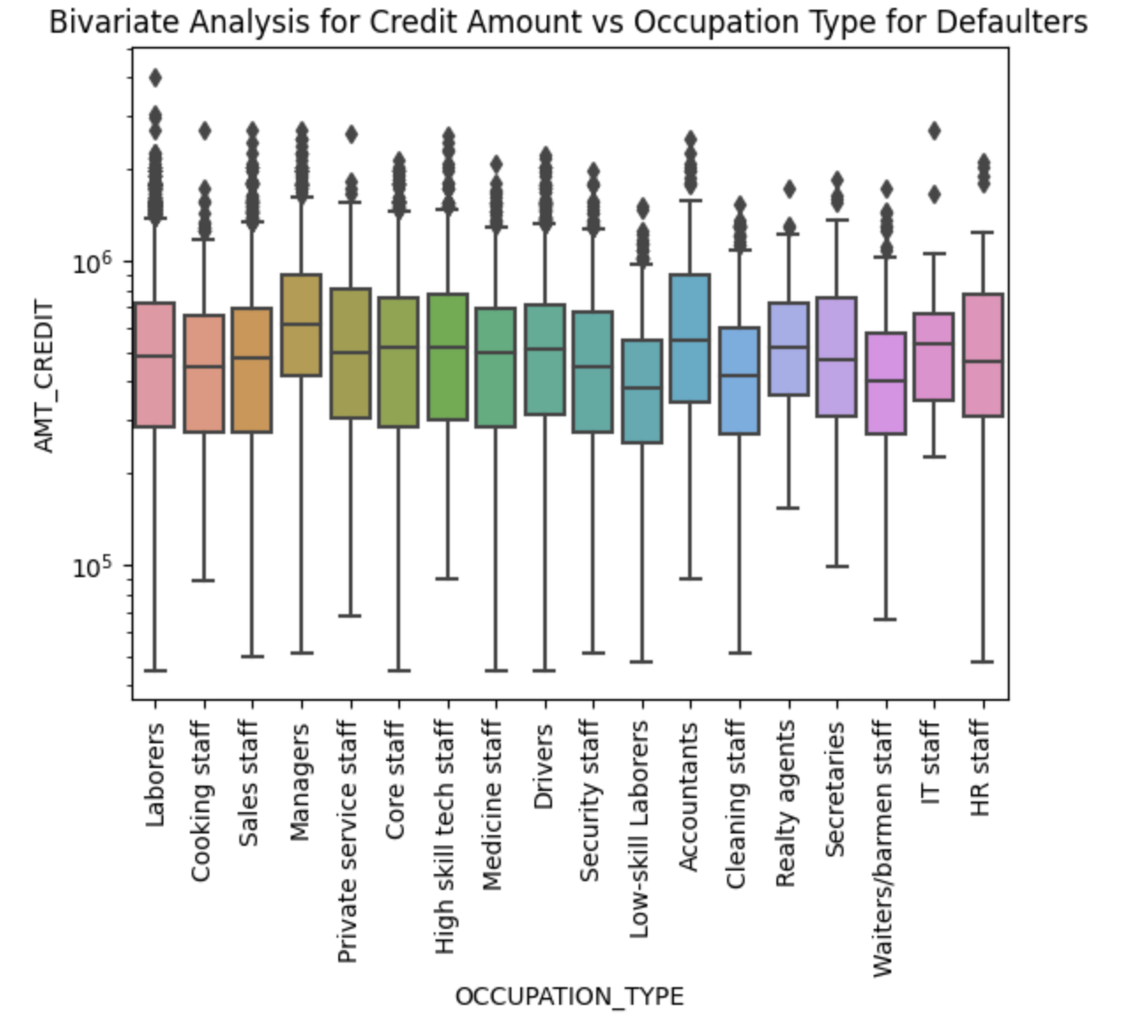
Distribution Of Credit Amount with Occupation Type
Managers are having higher credits than other.
Outliers are present for all Occupation types.
Low skill labourers has minimum credits.

Slide 19
Merged Data frames
Univariate Analysis
Bivariate Analysis

Slide 20
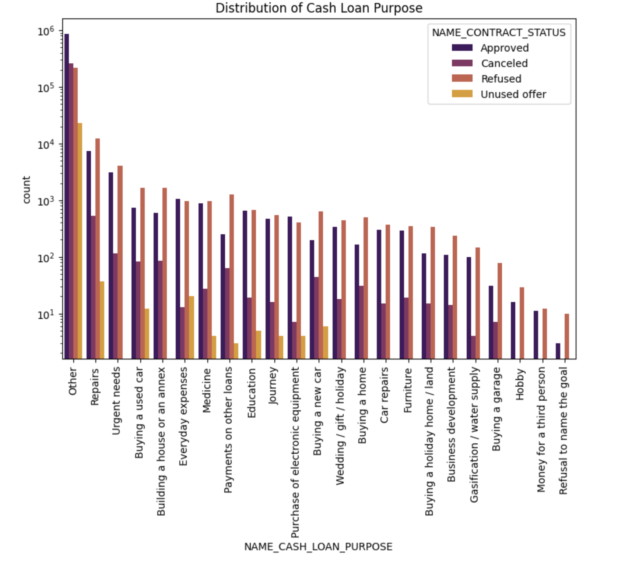
Distribution of Cash Loan Purpose
Maximum approved loans are for Others.
Most of loans are refused for the people who have 'Repairs' as their purpose.
Education as a purpose has almost equal number of Rejections and Approvals.
No offers are cancelled when purpose is Money for 3rd person, refusal to name the goal.
Buying a new car, buying an used car, buying a home or annex, Payments on other loans etc. are having more rejections

Slide 21
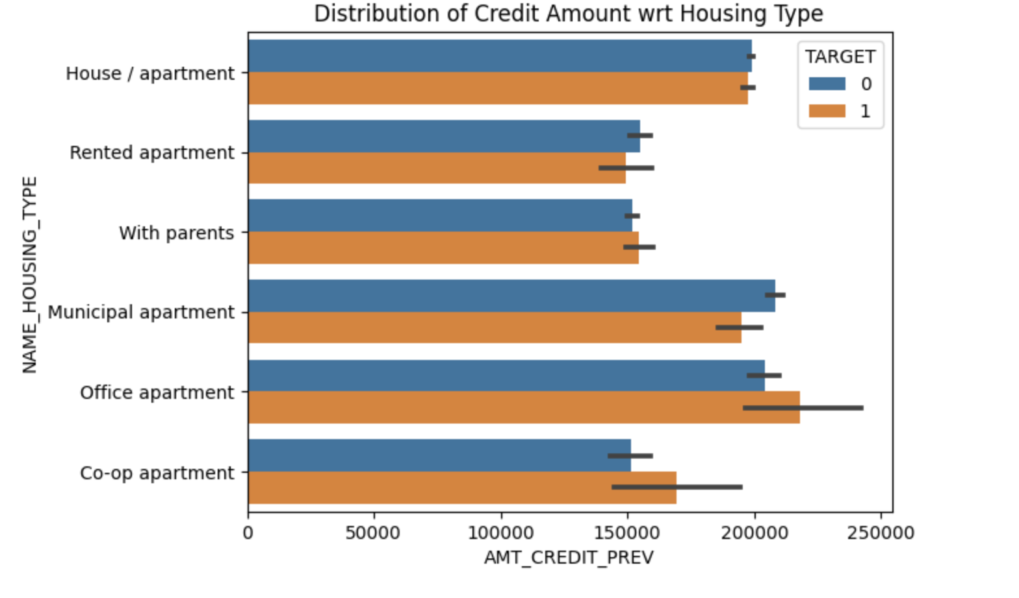
Distribution of Credit Amount with Housing Type
Those who have their own House/Apartments, Municipal Apartments are more likely to repay loan on time.
Those who are living in Office apartment, Co-op apartments are more likely have more difficulties repaying loan than others.

Slide 22
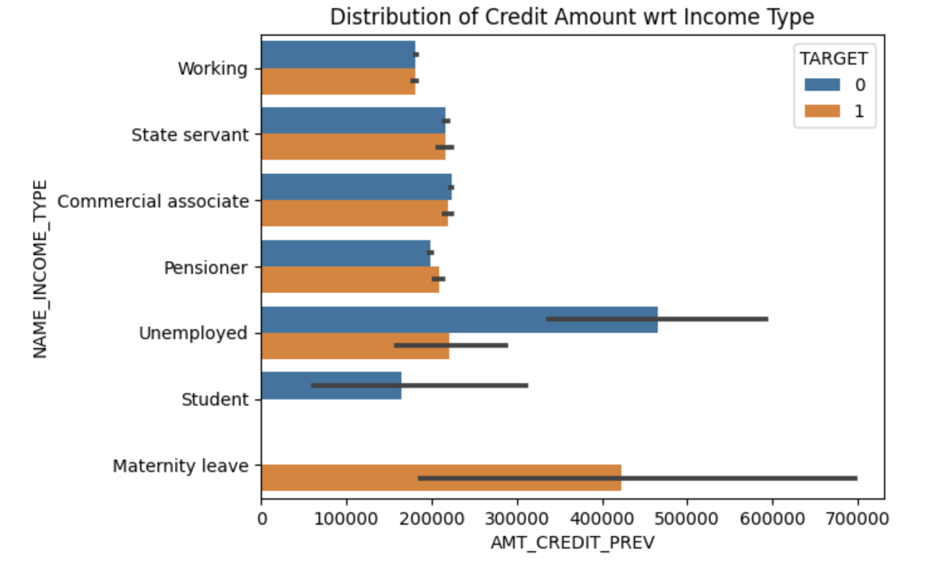
Distribution of Credit Amount with Income Type
Students are paying loans on time. There are no defaulters.
Those who are on Maternity leave are having difficulties repaying loan.

Slide 23
Conclusion
People living in own House/Apartments, Municipal Apartments should be targeted for giving loans as they are more likely to make successful repay of loan when compared to Co-op apartments .
We should focus on giving loans to Students as there are no defaulters for this Income Type.
People taking loan for Purpose not clear, Repairs and mentioned as Others are more likely to have Repayment difficulties.
People with family status- Widows and Separated people have more difficulty repaying loan.

Slide 24
Thanks!
z

